Slide 1
IHDS Individual Presentation
Student Number: 11326396
Data Acquisition
Data Linkage
Dashboard Creation
Outcomes of the Stakeholder Requirements
Risks Surrounding the Development
Reflection

Slide 2
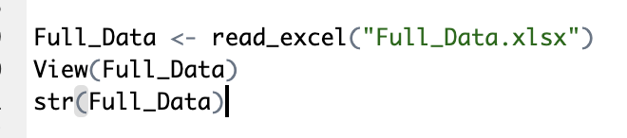
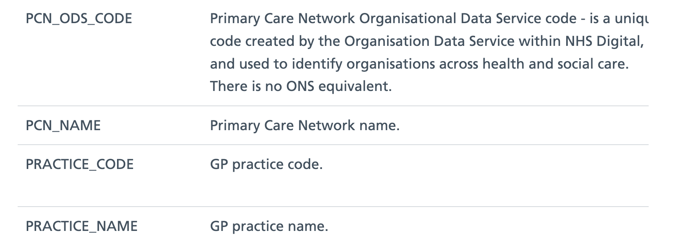
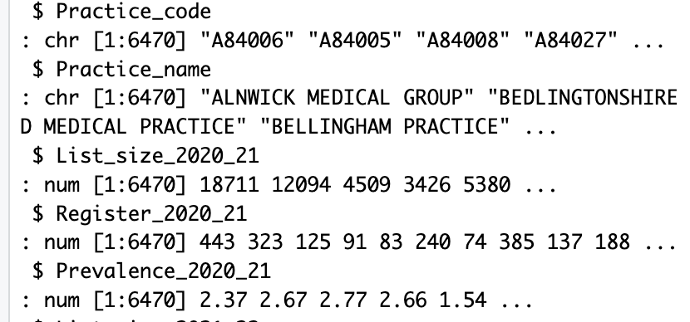
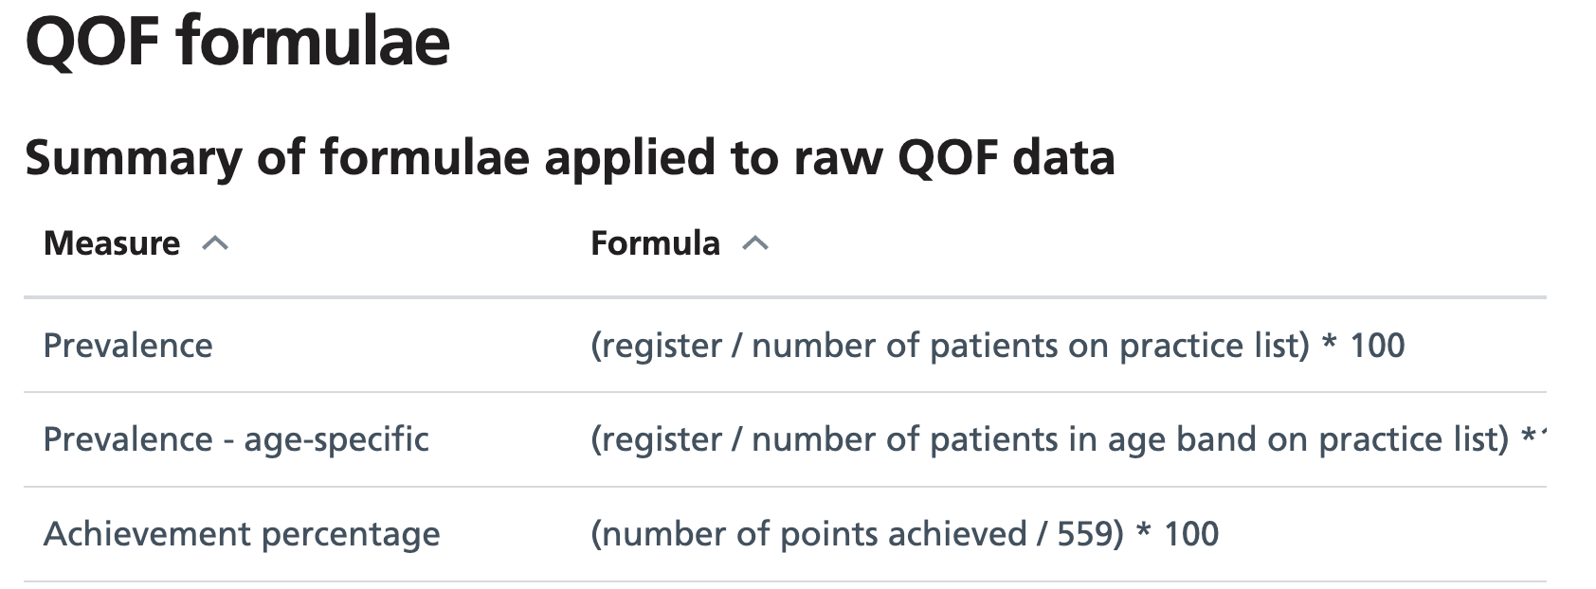
Data Acquisition
1. Understand and explore the datasets(use R and the website)
use R:
website introduction:
The datasets are about the information of GP and CCG(ICB), use R to briefly understand the content of the data set and the basic types of data, and use the website to gain a deeper understanding of what the data means and how it is calculated.
Notes:
The first step: Understand and explore the datasets
The website: https://digital.nhs.uk/data-and-information/publications/statistical/quality-and-outcomes-framework-achievement-prevalence-and-exceptions-data/2021-22/technical-annex

Slide 3
Data Acquisition
2. Choose the information that we think we needed:
For professionals:
Average numbers of every GP's patients
Achievement and prevalence of GPs
CCG achievement and CCG name in Manchester
COPD prevalence
For patients:
Postcode, name, phone number, average achievement of GPs
CCG address4, CCG name, CCG postcode, practice name, average COPD QOF prevalence
Notes:
The second step: Choose the information that we think we needed from the datasets, which relies on the information we get from related websites and the treatment process of COPD patients.

Slide 4
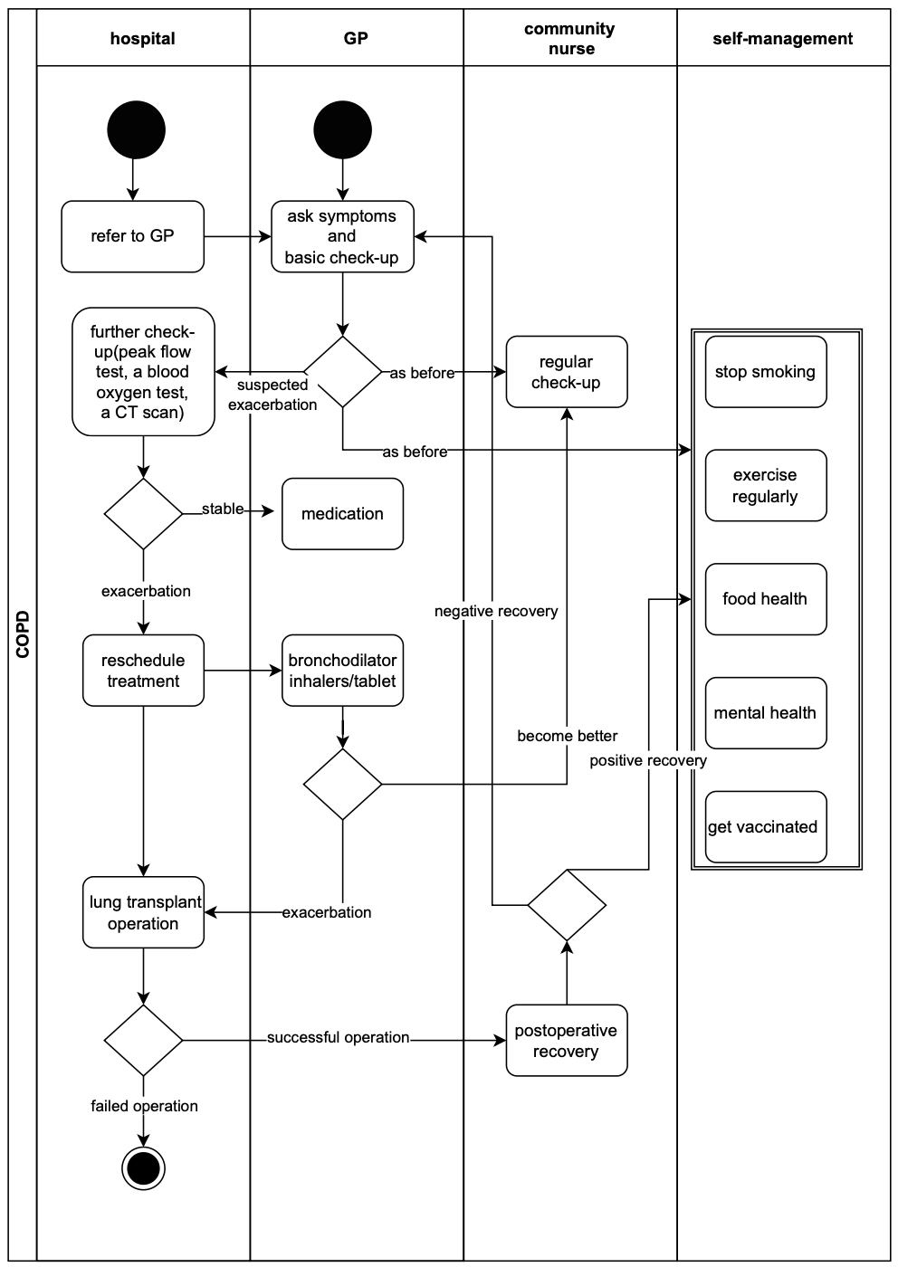
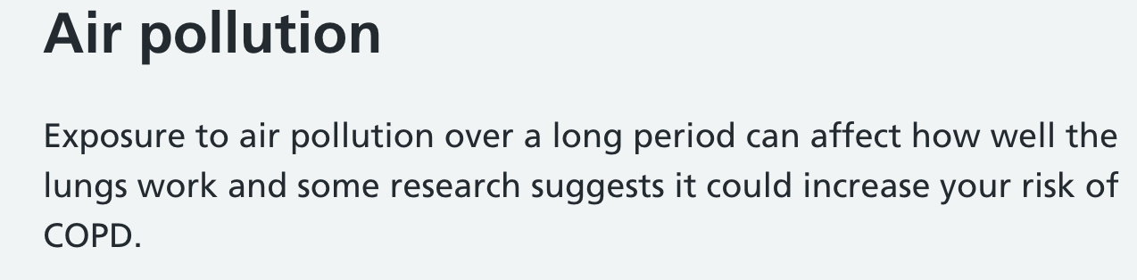
Data Acquisition
3. Consider other datasets related to COPD
From the swim lane diagram of treating COPD patients, we found that the self-management data of the patients is not included in the given dataset.
From the related information, we found one of COPD causes is air pollution.
So we decided to use the data of temperature and air pollution to help patients do the self-management.
(from the website https://www.weatheronline.co.uk/)
Notes:
The third step: Consider other datasets related to COPD

Slide 5
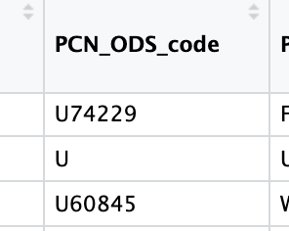
Data Linkage
Data linkage can make multiple datasets together to make the displayed information richer.
For data linkage in this case, we mainly used available attributes for linking, such as “Practice name" and “Practice Code”, considering the matching efficiency and difficulty, we used the “Code” to generate two datasets.
For some missing data, delete the row in which it is located, to make sure that every record is useful and accurate.
For some duplicate data after concatenation, we have carried out deduplication to ensure the uniqueness of the data.
Notes:
Choose the method of using available attributes for data linking, and do the initial data cleaning.

Slide 6
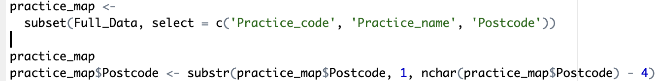
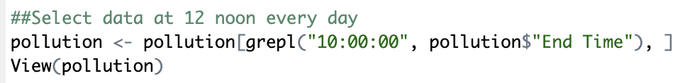
Data Linkage
1. CCG and ICB mapping:
As the Integrated Care Boards (ICBs) were established as statutory bodies from 1st July 2022, there is no data at CCG level.
So we using the mapping dataset to correspond ICB data and CCG data and display both as CCG.
2. Clean the given datasets:
To better show the data on the map, we choose some columns and deal with the data, such as removing the last four digits of the “Postcode”.
To better show the data on the weather change chart, we choose part of the data.
Notes:
Mapping data and clean data.

Slide 7
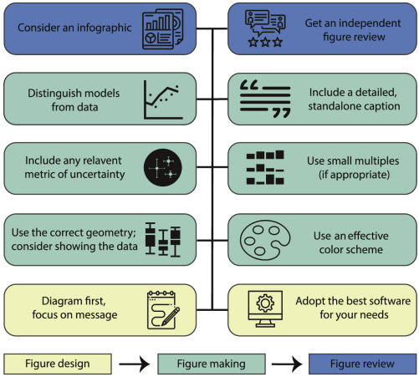
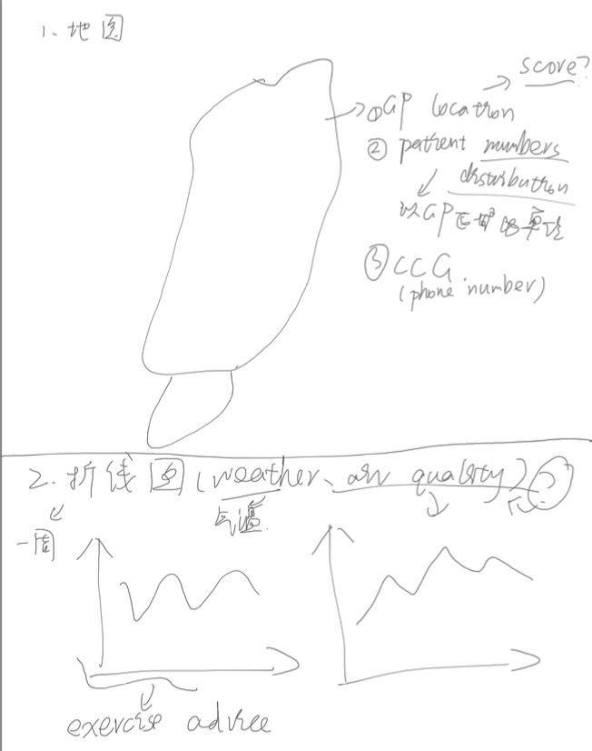
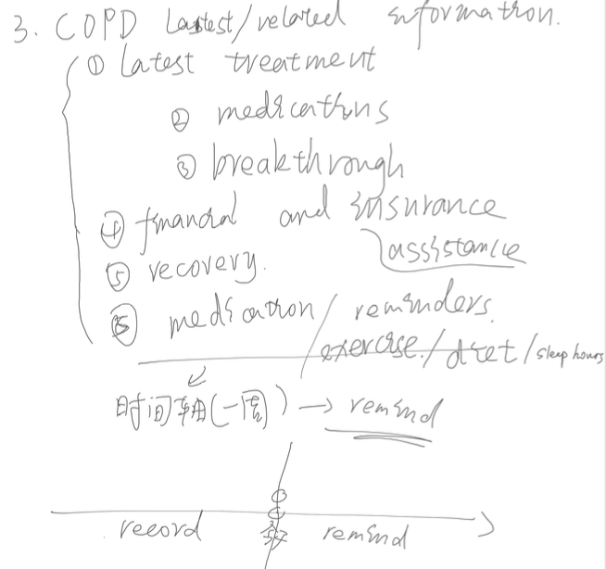

Dashboard Creation
The purpose of the dashboard is to enable the people who use it (patients and professionals) to obtain the information they need, and to obtain the information as simply and clearly as possible.
1. Design the figures based on the information and use the software(learn first).
Simple is better!
tableau can meet the various forms of graphs
that we need
Notes:
Design the dashboards

Slide 8
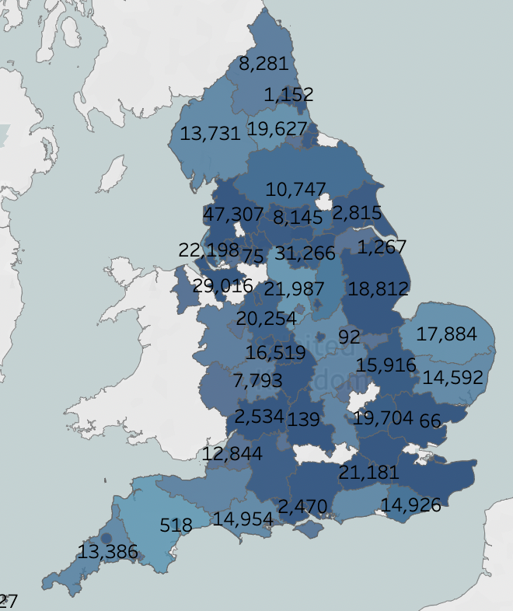
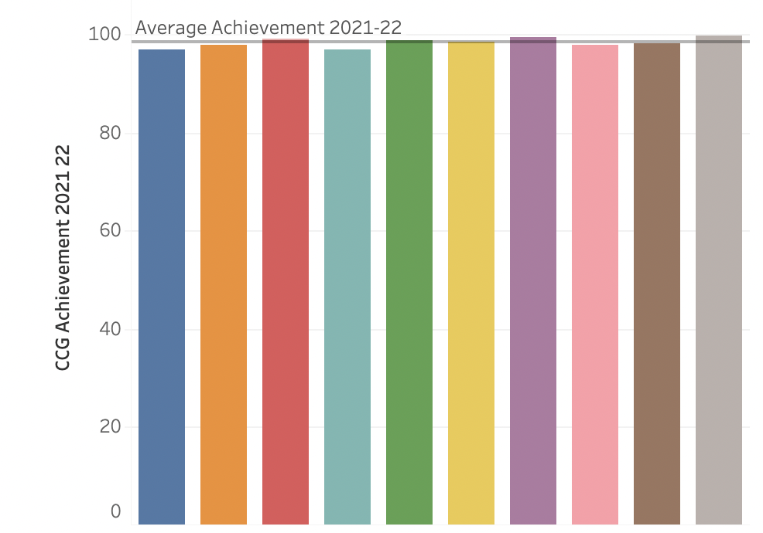
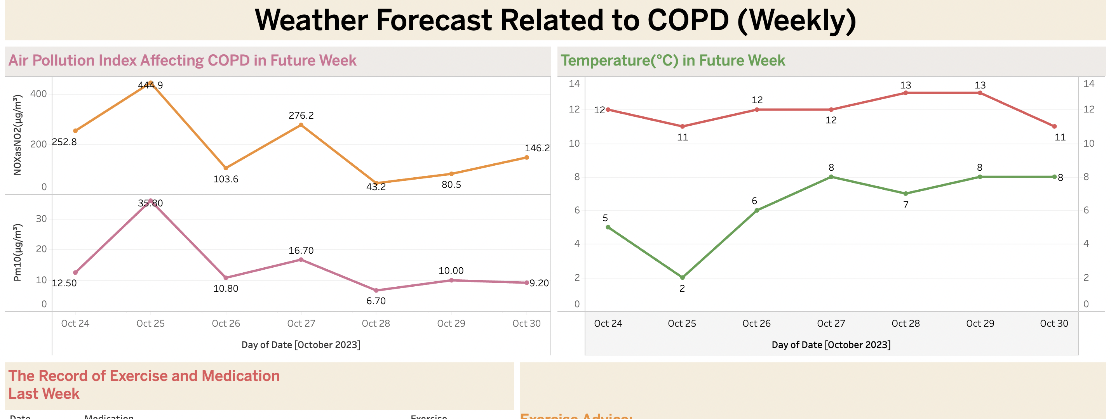
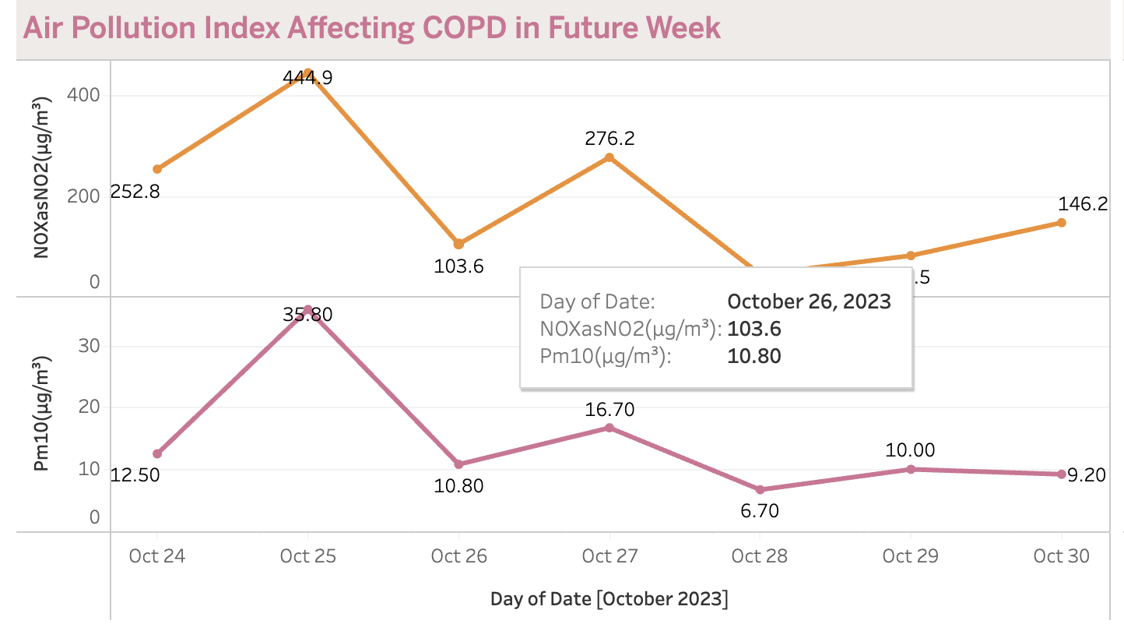
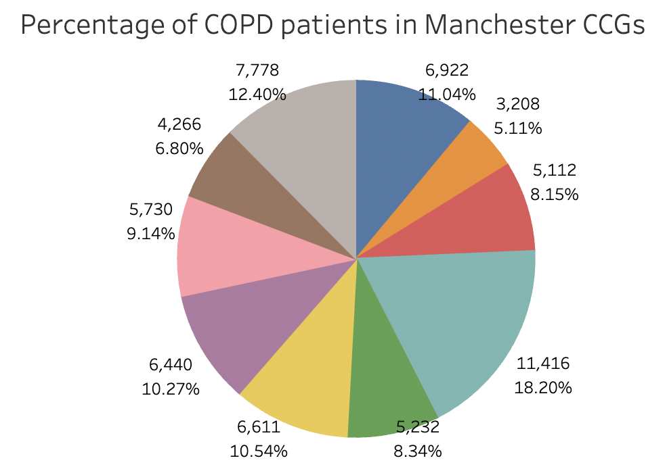
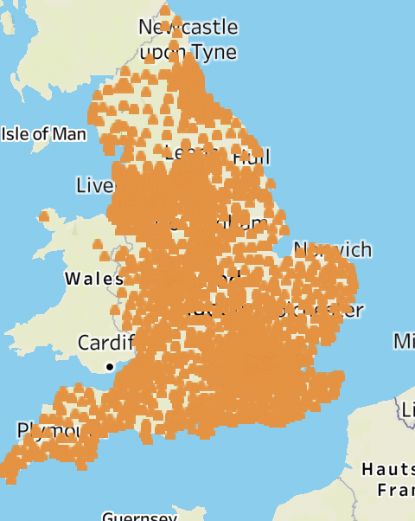
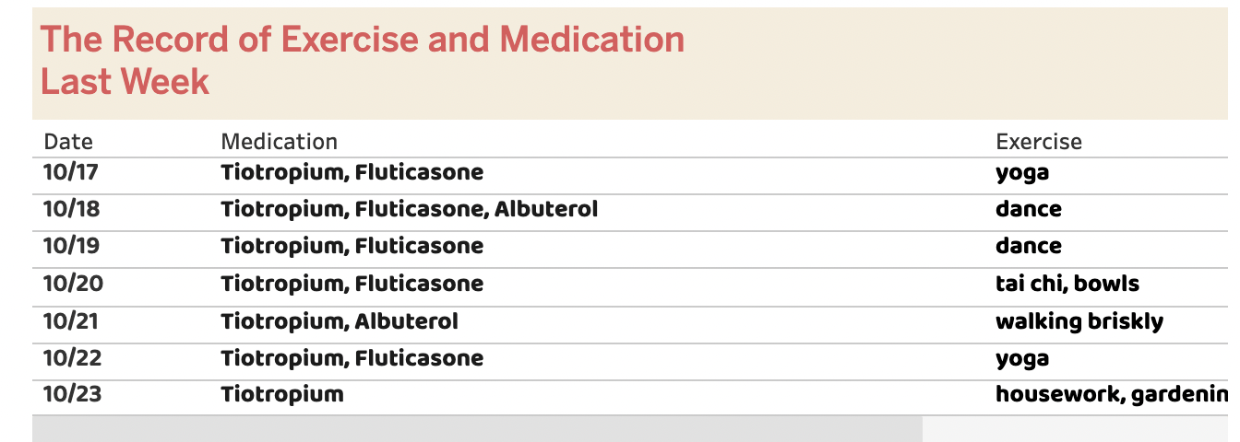
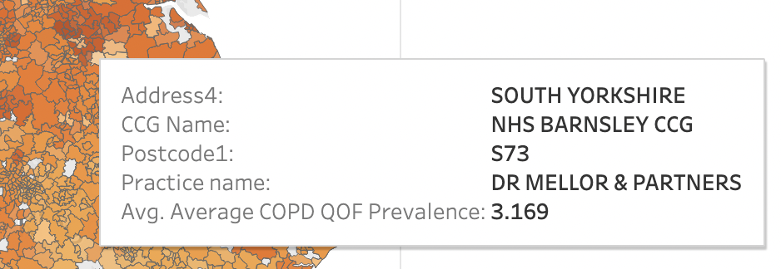
Dashboard Creation
2. Make the figures following simple and easy-to-understand principles.
Simple is better!
Use similar background colors, the theme and line use the same color
Use maps, line charts, bar charts, table and pie charts to represent data respectively
Notes:
Make the dashboards.

Slide 9
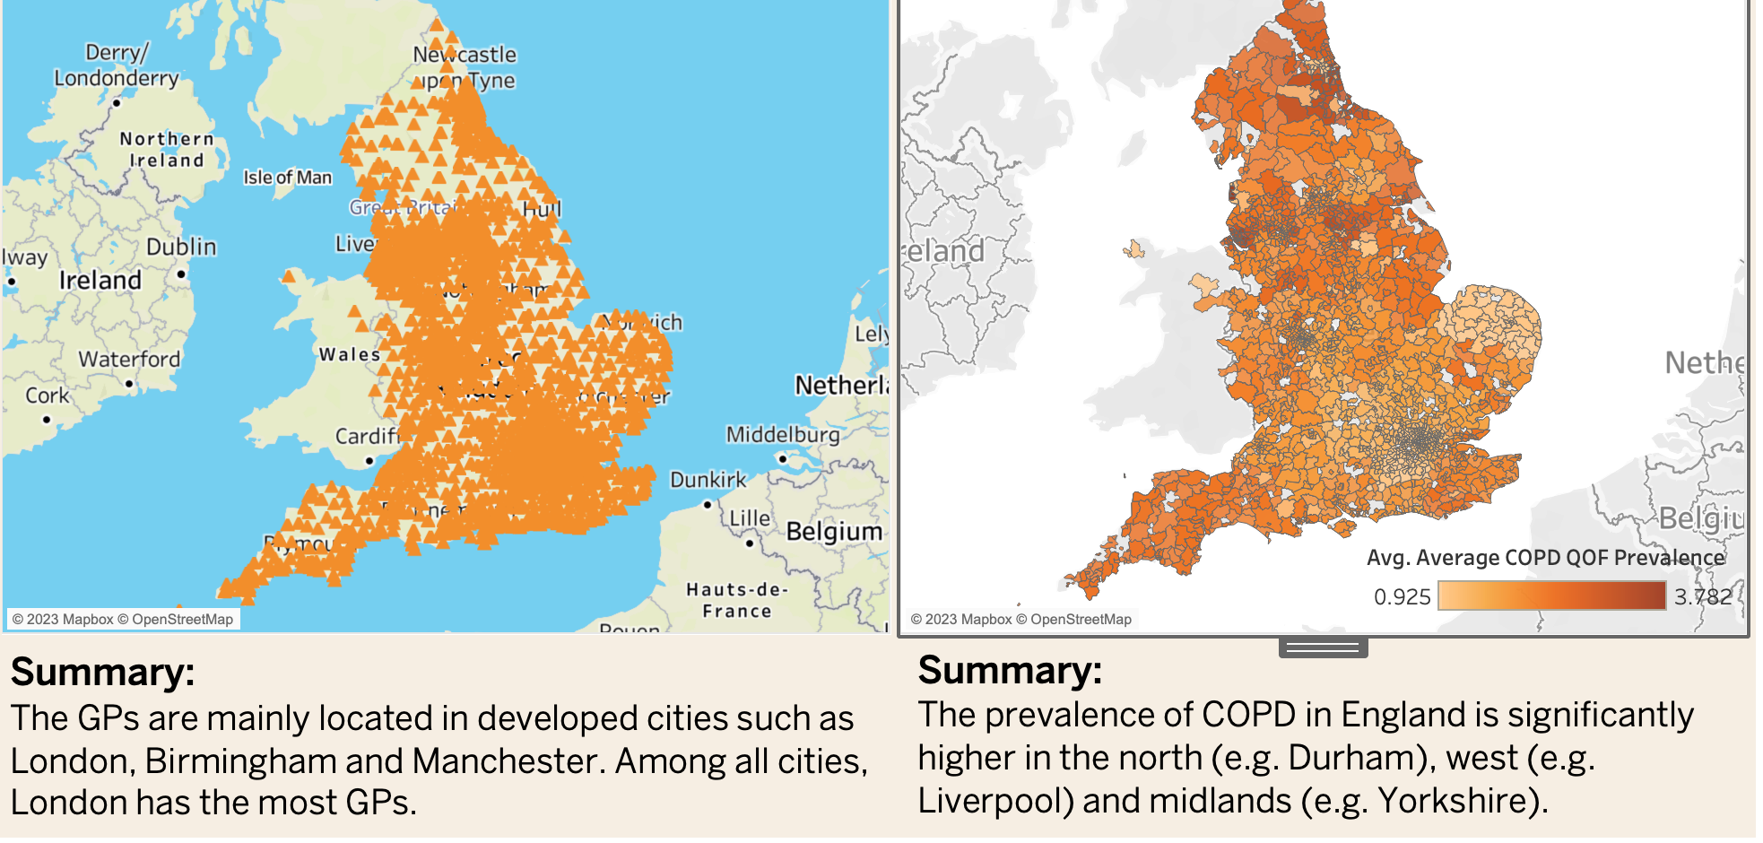
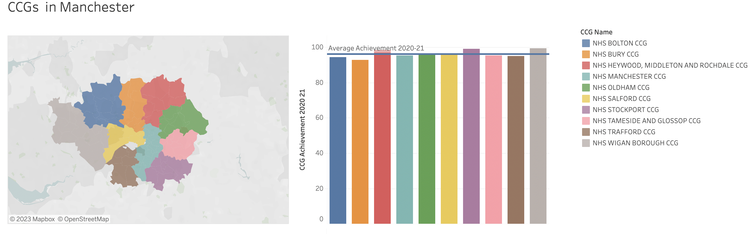
Dashboard Creation
3. Review the figure. (Use concise and accurate words to describe and summarize the information in the figures.)
Simple is better!
Notes:
Review the dashboards.

Slide 10
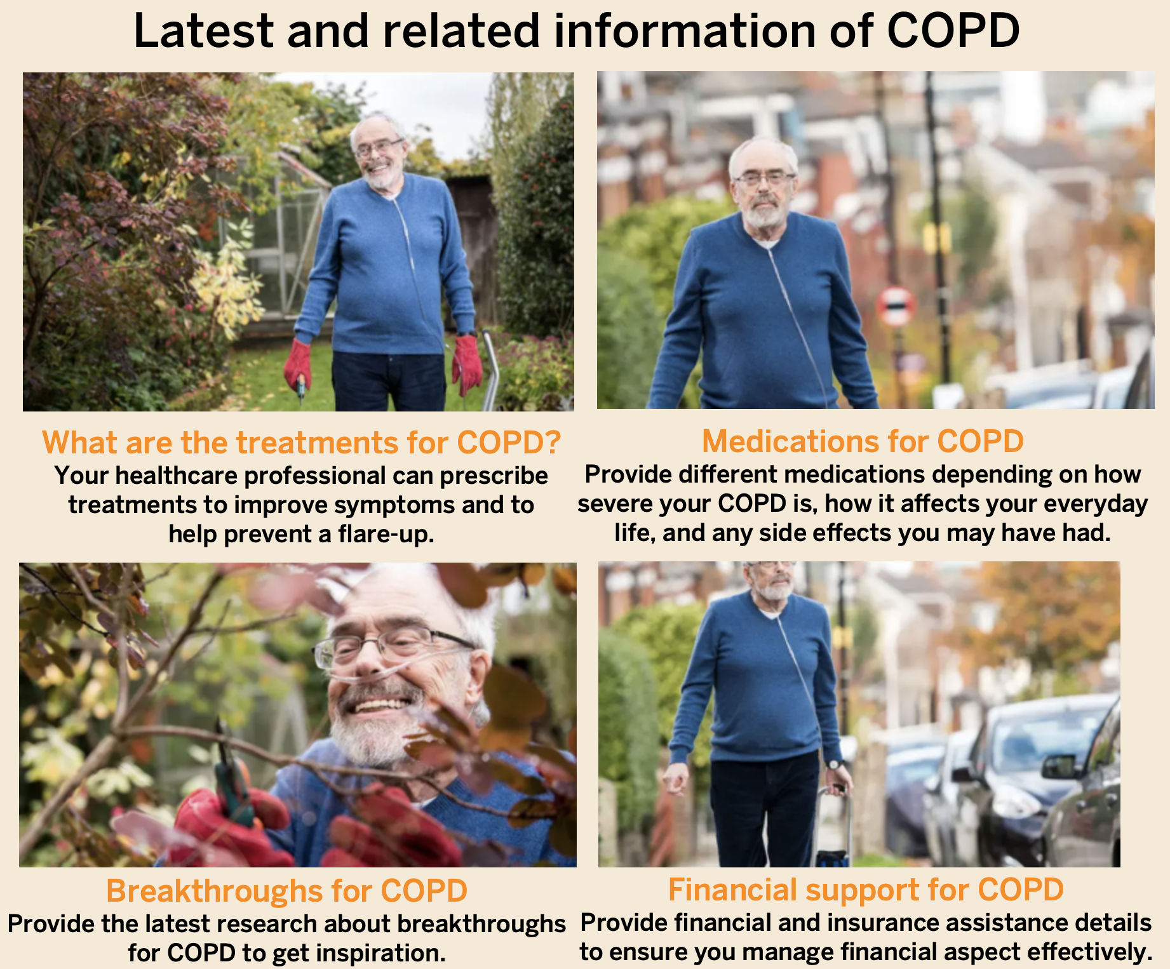
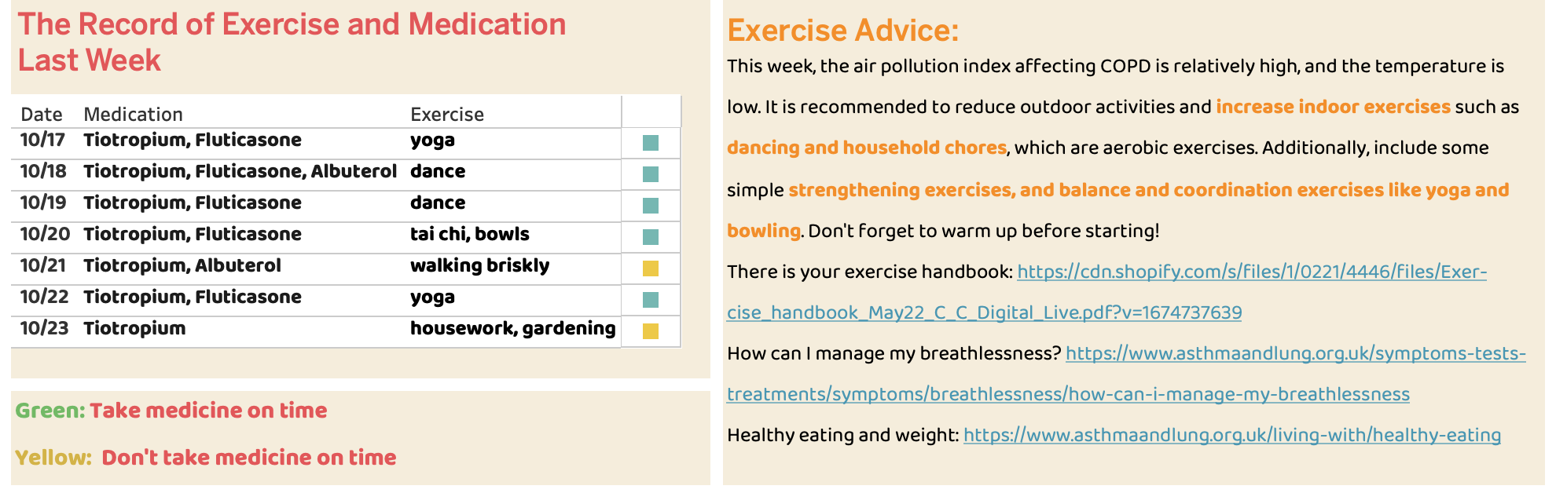
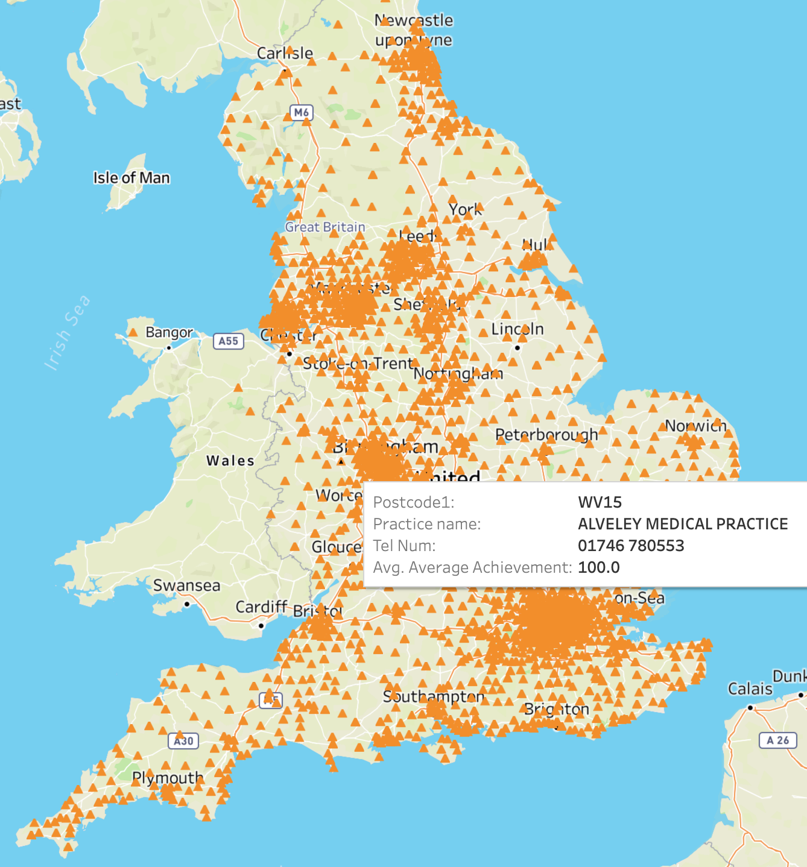
Outcomes of the Stakeholder Requirements
Patient requirements:
Information needs:
Any financial or insurance assistance programs
Search treatment information as needed
Check out community support information
Clear and update information about COPD management.
Information related to exercise and rehabilitation
See the history record
Change a new GP, meet more new people who have same symptom as me.
Give a GP map to enable patients to
find nearby GPs and get their details
Patient visualization needs & preferences are in notes.
Notes:
Patient visualization needs & preferences:
Clear, easy to understand and relevant to my condition, prefer text
Updates on local air quality and weather
Medication reminders
Symptom tracking
Recording sleeping time and diet
Connections to COPD support community
Some advice on exercise.

Slide 11
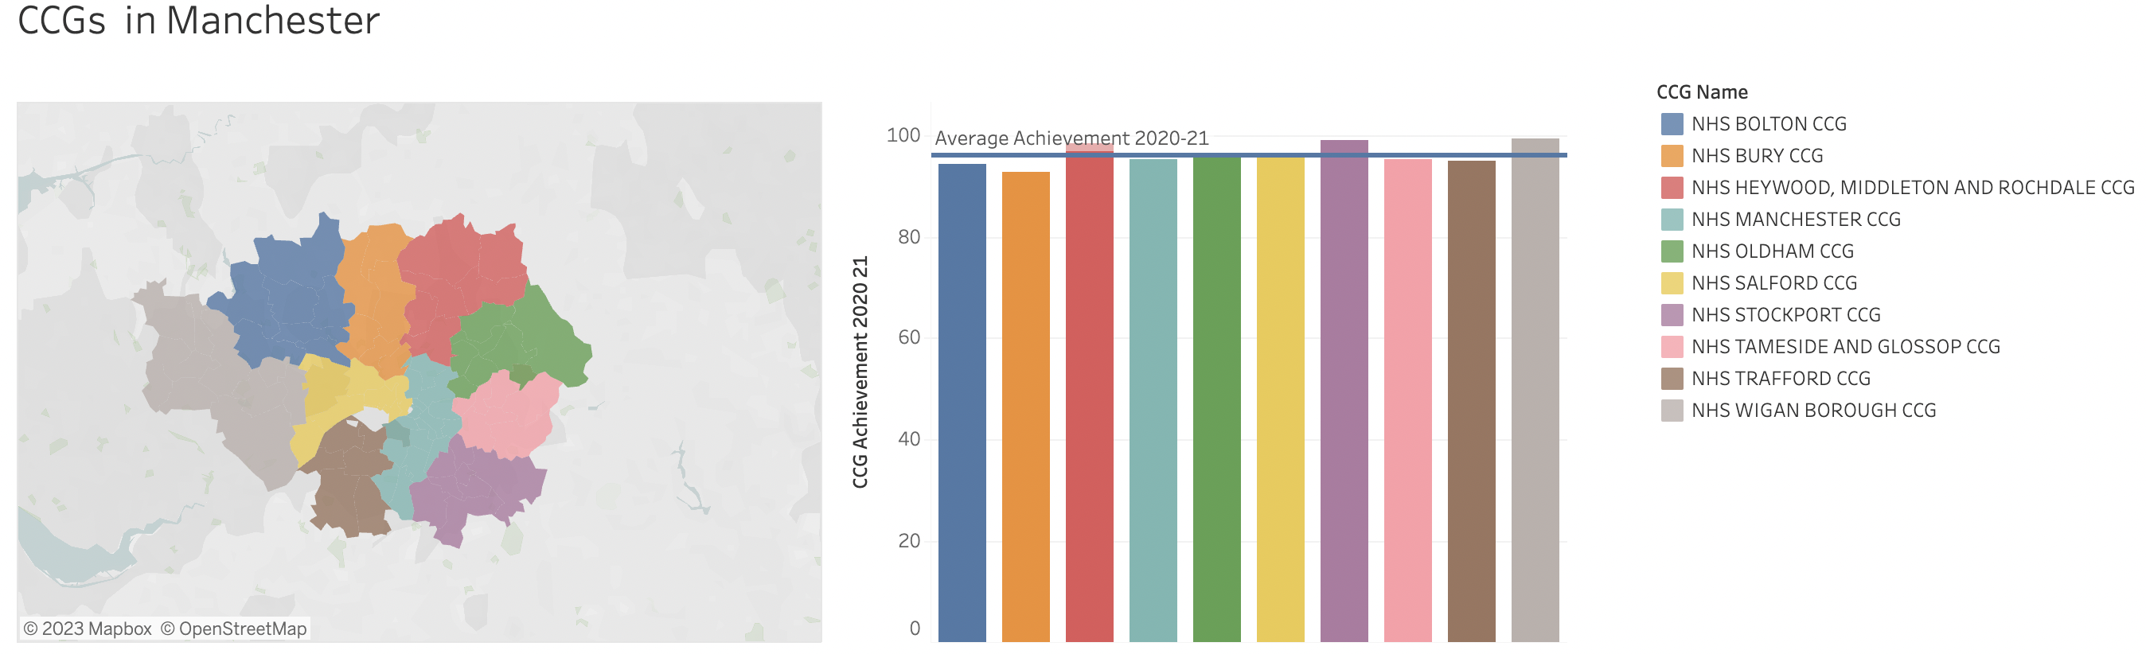
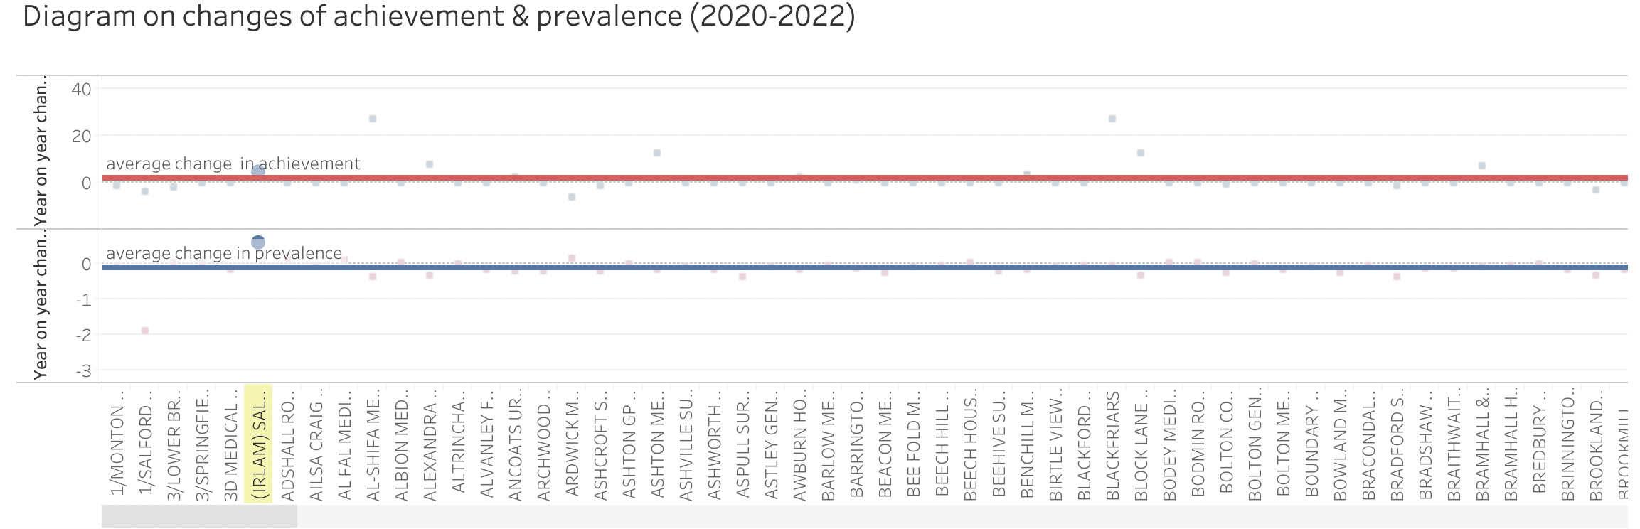
Outcomes of the Stakeholder Requirements
Professional requirements:
Information needs:
Make CCG comparisons
My region or our particular GP practice have high or low COPD cases relative to national averages
Sort of an indicator of which GP practice performing well
Sort of both overall achievement scores and the individual breakdown of the achievement scores for the different indicators
Professional visualization needs & preferences are in notes.
Notes:
Professional visualization needs & preferences:
Maps of COPD prevalence across the UK and making the sort of national comparisons
Present a figure and have some way of seeing what visualizing the raw data behind that.
Highlight particular areas
Create a graph with all the CCGs.

Slide 12
Outcomes of the Stakeholder Requirements
For professionals, their needs are knowing the overall situation, such as the performance of the overall GPs within a certain range and the prevalence of COPD in various areas, as well as the changes in these data over time, which is easy to analyse and provide the next step plan.
For COPD patients, their needs are more personal and detailed. They hope to see COPD-related information in time and to connect with institutions that can provide them with support (both physical and spiritual).
In the dashboards, we compare the CCGs’ achievement and prevalence in different areas of Manchester, give diagrams on changes of achievement & prevalence (from 2020 to 2022), draw a map of COPD prevalence.
In the dashboards, we give a map of GPs, provide COPD related and latest information, record the exercise and medication of patients last week, remind the patients about the air pollutants and temperature next week.
To meet
the need
To meet
the need
Notes:
The summary of professional requirements and patient requirements, and how the dashboards meet these requirements.

Slide 13
Risks Surrounding the Development
1. Data privacy
As the dashboards record the exercise and medication of patients, and provide local weather, the patients’ information are collected, so how to protect patients’ privacy is important, what we can do is access controls, and compliance with data protection regulations(like HIPAA and GDPR).
2. Information accuracy
As the data of dashboards all come from the datasets, so how to get the accurate and authentic data is important, wrong information leads to wrong decisions. We need to do is distinguishing whether the data is reliable by understanding whether the publishing organization is authoritative, the path to obtain the data, the calculation method of the data, etc.
Notes:
The risk of data privacy and information accuracy in the development and how to solve them.

Slide 14
Risks Surrounding the Development
3. Information misunderstanding
As some dashboards for professionals are not understood at a glance, a title of a diagram is not enough, which will lead to wrong decision-making, and also waste time to understand the content. So adding some summary and review is necessary, as well as the website and the data source.
4. Incompatibility between systems
EHRs (Electronic Health Record) in different healthcare systems in UK have different methods and forms, so HIE (Health Information Exchange) are difficult to implement between healthcare systems, facing situation like this, we can use standardized data formats and APIs, to make the dashboard more effective.
Notes:
The risk of information misunderstanding and incompatibility between systems in the development and how to solve them.

Slide 15
Reflection
Data Quality Assurance: Ensuring the accuracy and reliability of the datasets is important, but we just learn about what the data is, not carefully check whether there are errors or some unreasonable places in the datasets. Next time I will pay close attention to data quality assurance, implementing checks to identify and address any inaccuracies in the datasets.
Data Explanation: When building the dashboards, we didn’t give serious thought to whether users can quickly understand the information we provide, so the explanation and the summary of data is not enough, next time I will give short but clear description of every part in the dashboards.
Notes:
If I repeat the exercise, I will make the data quality assurance and add more data explanation.

